Slide 1
PATEL CHINTAN (130120119136)
POLARA JAYDIP (130120119178)
PATEL HARSH J (130120119140) PATEL HARSHIL (130120119142) , ASHUTOSH KUMA(130120119009)
TOPIC:AIR WAYS (Transportaion Engineering)
Pof Krishna B Suchak
Civil Engineering Department
Gandhinagar Institute of Technology

Slide 2
Flow Of the presentation
Introduction to the word TRANSPORTATIONS.
Transport infrastructure
Mode of Transport
Airport engineering

Slide 3
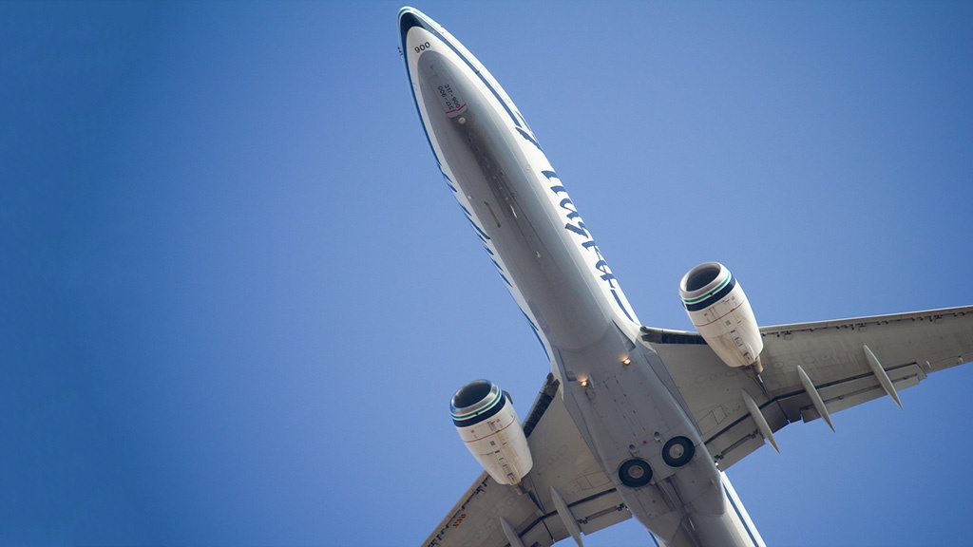
Transport or
Transportation is the movement of people, animals and goods
from one location to another.
Modes of transport include air, rail ,road ,
Water , cable ,pipeline and space.
The field can be divided into infrastructure, vehicles and operations.

Slide 4
Transport infrastructure
Transport infrastructure consists of the fixed installations necessary for transport, including roads, railways, airways, waterways, canals and pipelines and terminals such as airports, railway stations, bus stations, warehouses, trucking terminals, refueling depots (including fueling docks and fuel stations) and seaports. Terminals may be used both for interchange of passengers and cargo and for maintenance.

Slide 5
Mode of Transport
Air
Road
Rail
Water
Other Modes (pipe lines)

Slide 6
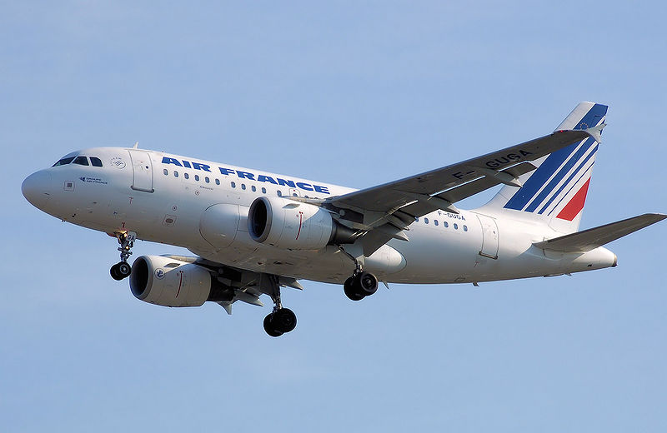
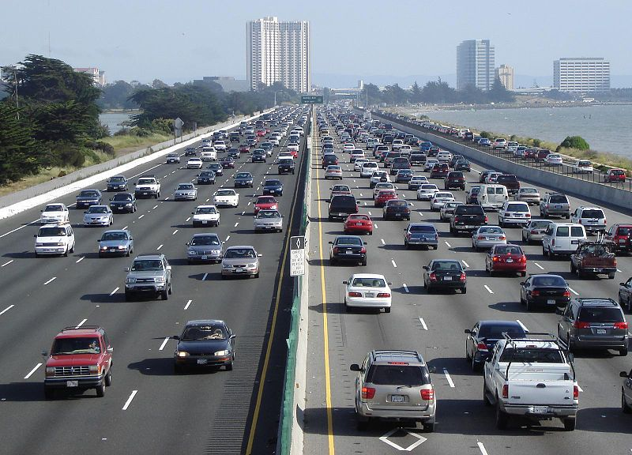
AIR
ROAD

Slide 7
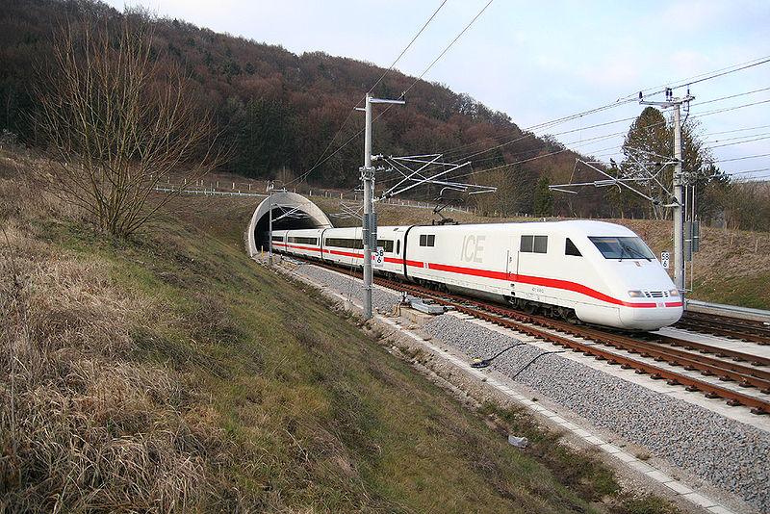
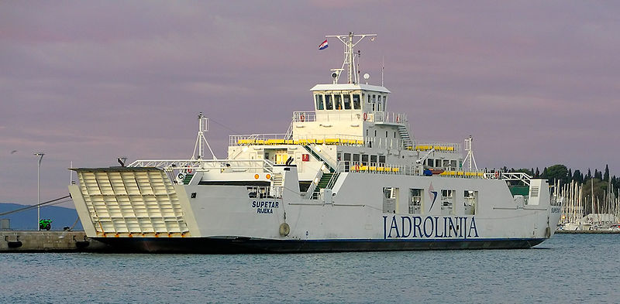
RAIL
WATER

Slide 8
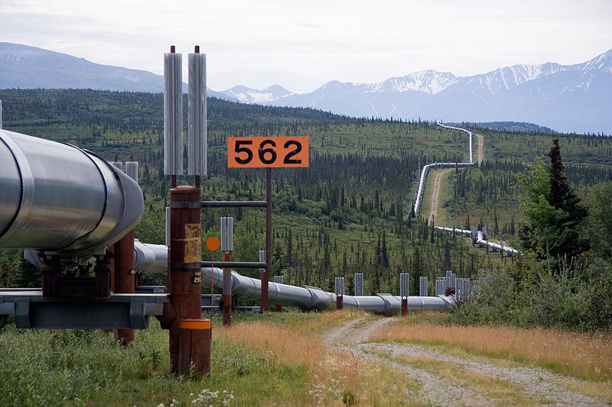
Other (pipe line)

Slide 9
Air
A fixed-wing aircraft, commonly called airplane, is a heavier-than-air craft where movement of the air in relation to the wings is used to generate lift. The term is used to distinguish from rotary-wing aircraft, where the movement of the lift surfaces relative to the air generates lift. A gyroplane is both fixed-wing and rotary-wing. Fixed-wing aircraft range from small trainers and recreational aircraft to large airliners and military cargo aircraft.

Slide 10
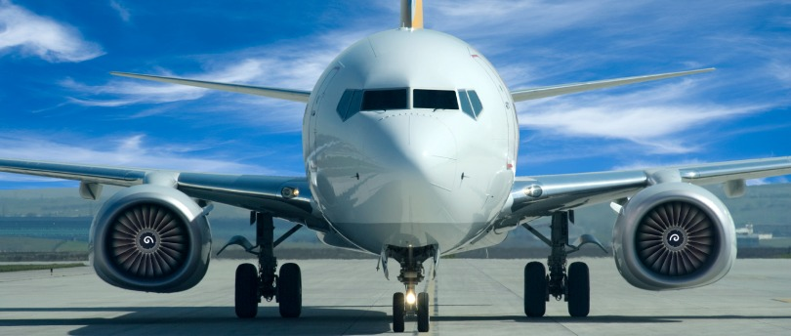
The aircraft is the second fastest method of transport, after the rocket.

Slide 11
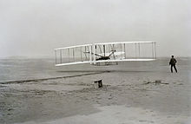
“The Wright brothers “ first flight in 1903.

Slide 12
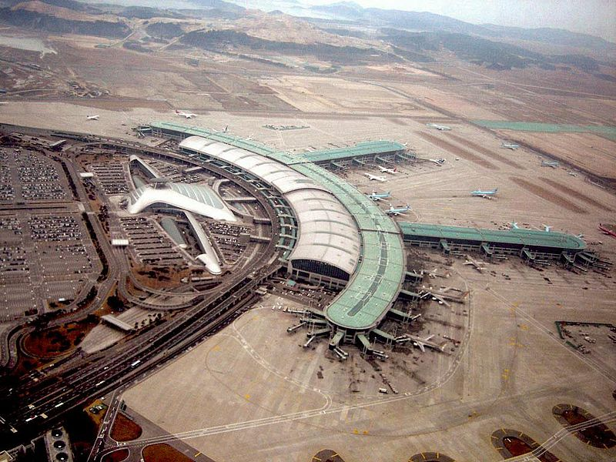
AIRPORT (South Korea)

Slide 13
Airport engineering
Airport engineers design and construct airports. Airport engineers must account for the impacts and demands of aircraft in their design of airport facilities. These engineers must use the analysis of predominant wind direction to determine runway orientation, determine the size of runway border and safety areas, different wing tip to wing tip clearances for all gates and must designate the clear zones in the entire port

Slide 14
THANKS

